Slide 1
A remedy for stress
Basic 08 Unit 10b

Slide 2
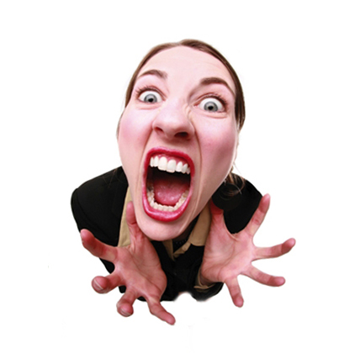
When you feel stressed, what do you do?

Slide 3
When I feel stressed, what do I do?
Last year I was a high school student. I finished high school and now my life is going to change. Now, I am on vacation, but next month I have my entrance exam for the university. I feel very stressed because it is a difficult exam. Whenever I am under a lot of pressure, I ………

Slide 4
When I feel stressed, what do I do?
Hi, my name is …. Last year I was a high school student. I finished high school and now my life is going to change. Now, I am on vacation, but next month I have my entrance exam for the university. I feel very stressed because it is a difficult exam. Whenever I am under a lot of pressure, I ……. Also, sometimes, I feel stressed when…

Slide 5
Title
In the first sentence, tell me about you. Then, tell me some information about you and your life. Then, tell me what you did when you trained, or practiced the sport

